Slide 1

ASSIGNMENT GUIDELINES
Make the changes in the PPT as you solve the parts
This file contains the template for the EDA part of the project.
Check the instructions added in the note section of every slide for clarity.
Don’t move around any image or text box
If you require more/lesser elements, be careful when you copy/delete the existing ones.

Slide 2
ASSIGNMENT Name: …Jayshree Kasera………………………..
Problem Statement
Bank of Corporate conducted a telemarketing campaign for one of its financial products, ‘Term deposits’, to build a long-term relationship with the existing customers. Your goal is to identify the target customers for the term deposits from the pool of the bank’s existing customers. You should also capture the key driving factors (or driver variables) behind the successful conversion of a customer, i.e., the customer opening a term deposit account with the bank.
Assignment Objective
To identify the target customers and the driving factors behind a successful customer conversion for future marketing campaigns.
Notes:
Problem Statement

Slide 3
PART I : Univariate Analysis
Variable under consideration :- MARITAL STATUS
This bar graph indicates people who are married, divorced ,
single registered under the bank. Under this analysis
It is indicated that the ban has maximum no. of married
People as customers.
Notes:
Mention the results of the excel analysis and add the corresponding visualisations to the space provided above. Use copies of the above slide if necessary.

Slide 4
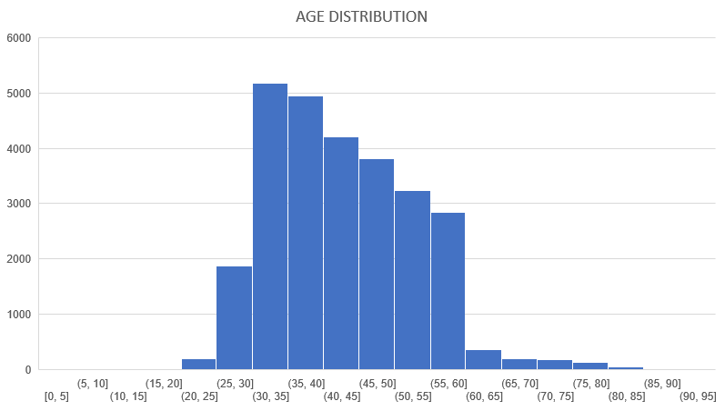
PART I : Univariate Analysis
Variable under consideration: Age of the account holders
This Histogram reflects the age distribution of customers. Under this we can see that the maximum no. of customers are aged between 23-33
Notes:
Mention the results of the excel analysis and add the corresponding visualisations to the space provided above. Use copies of the above slide if necessary.

Slide 5
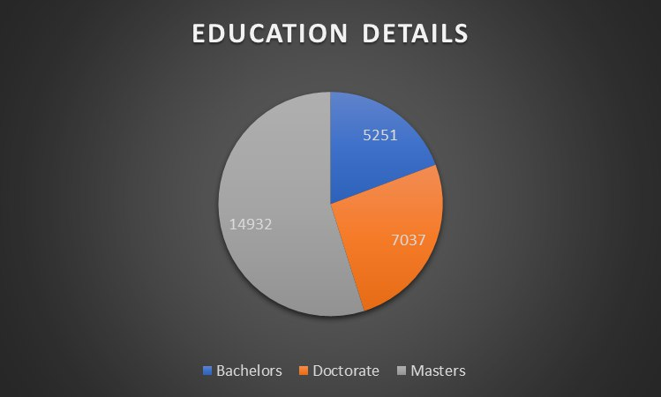
PART I : Univariate Analysis
Variable under consideration: EDUCATION
This pie chart Indicates the total distribution of educated people in different sectors. As according to the data it reflects that there are most no. have completed there masters.
Notes:
Mention the results of the excel analysis and add the corresponding visualisations to the space provided above. Use copies of the above slide if necessary.

Slide 6
PART II : Bivariate Analysis
Variable under consideration: previous vs poutcome
The Horizontal Graph below shows the product success rate over the call . It is clearly visible in the graph that most of the calls were failure for the different products.
Notes:
Mention the results of the excel analysis and add the corresponding visualisations to the space provided above. Use copies of the above slide if necessary.

Slide 7
PART II : Bivariate Analysis
Variables under consideration: AGE VS JOB
This line graph reflects the distribution of job into different sector with consideration to age. Here we can that mostly people aged between 33-38 are into every respected sector.
Notes:
Mention the results of the excel analysis and add the corresponding visualisations to the space provided above. Use copies of the above slide if necessary.

Slide 8
PART II : Bivariate Analysis
Variables under consideration: job VS EDUCATION -
This bar graph reflects the job vs education
Notes:
Mention the results of the excel analysis and add the corresponding visualisations to the space provided above. Use copies of the above slide if necessary.

Slide 9
PART II : Bivariate Analysis
Variables under consideration: Call Duration vs Last contacted
This slide below reflects what was the call volume and duration of the call
Notes:
Mention the results of the excel analysis and add the corresponding visualisations to the space provided above. Use copies of the above slide if necessary.

Slide 10
PART II : Bivariate Analysis
Variables under consideration: Call Duration vs Poutcome
The pie chart below shows that how many calls have successfully been converted. This over here reflects that most of the calls did not converted as customer has given no answer for the product being offered.
Notes:
Mention the results of the excel analysis and add the corresponding visualisations to the space provided above. Use copies of the above slide if necessary.

Slide 11
PART III: Major insights

